Slide 1

Groomsoft
Syd366 – Naa Professor Cindy Laurin shabnoor sayed(133649194)
Group#4 individual presentation

Slide 2
Why Groomsoft?
Cloud Based Software, therefore Supports all operating systems and cross platforms.
User-friendly and easier to use and learn.
Can access data anywhere without any specific installations.
Auto data backup each night.
Sympathy gifts for Pets
Provides features like bulk texting, appointment calendar, managing customers, route optimization, secure payments and data storage

Slide 3
Key Features:
Pet Grooming Software Appointment Calendar
Pet Grooming Software Text Messaging
Managing Customers and Pets
Route Optimization
Pet Groomer Software Reporting
Cross Platform Software
Pricing

Slide 4
Pet Grooming Software Appointment Calendar:
Create recurring appointments
Block days off/ holidays
Email reminders
Waitlist
Appointment summary

Slide 5
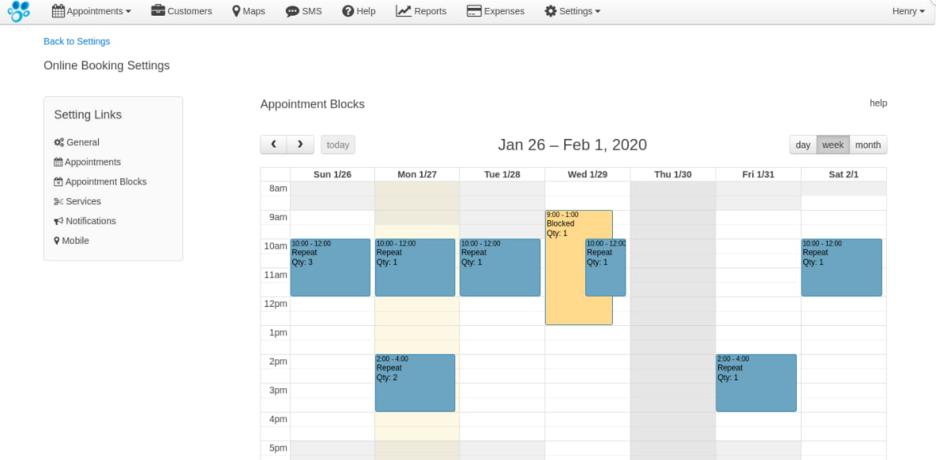

Slide 6
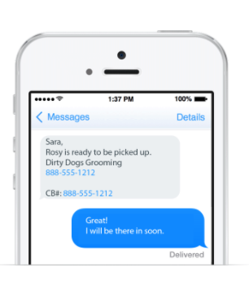
Pet Grooming Software Text Messaging:
Text message reminders
Bulk texting
Text status

Slide 7
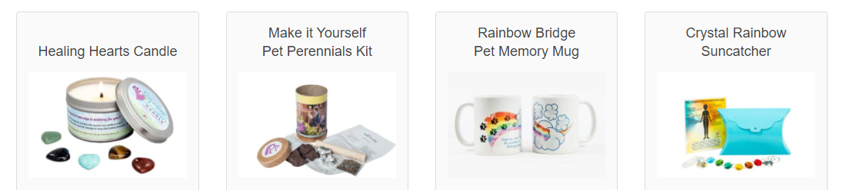
Managing Customers and Pets:
Can add unlimited users
Sign able templates
Email marketing
Customers and pets tagging to distinguish
Detailed customers and their pets profile
Vaccination tracking
Pets picture upload option
Sympathy gifts

Slide 8
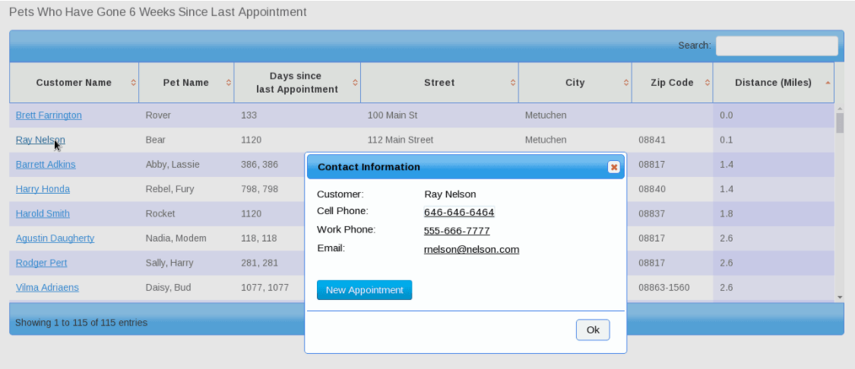
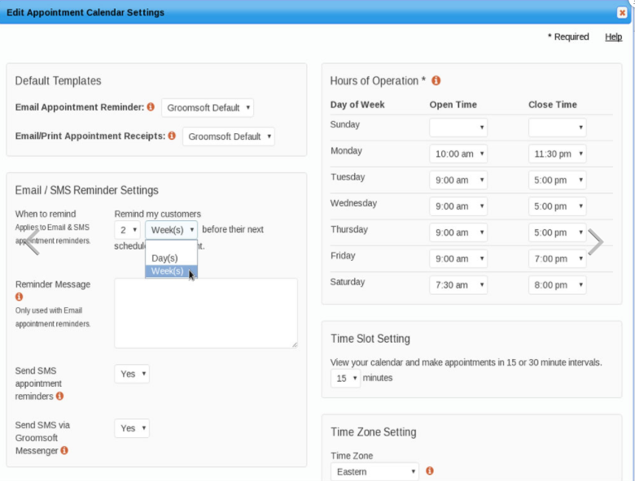

Slide 9
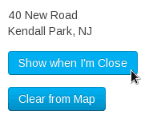
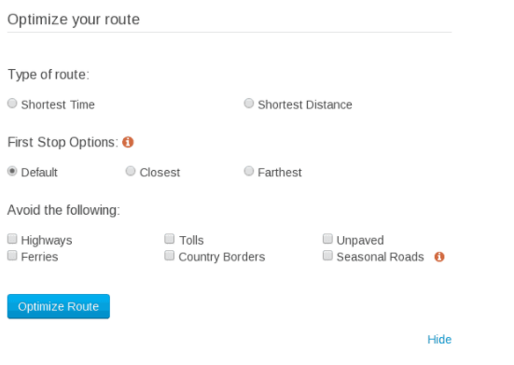
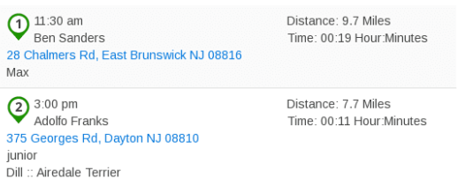
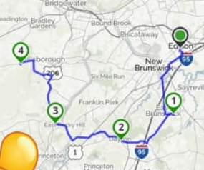
Route Optimization:
Optimize the appointments route according to your needs.
Shows the shortest route
Maps to show the places to need to be in order.
Option to notify when you are about to reach the destination.

Slide 10
Pet Groomer Software Reporting:
Audit report
Pet list, customer list, last appointment, pets birthday, vaccination etc
Expense reports
Sales reports classified by dates, zip codes, payments, payment types etc
Coupon, product and service lists
All the reports can be downloaded and printed, and are in CSV file.

Slide 11
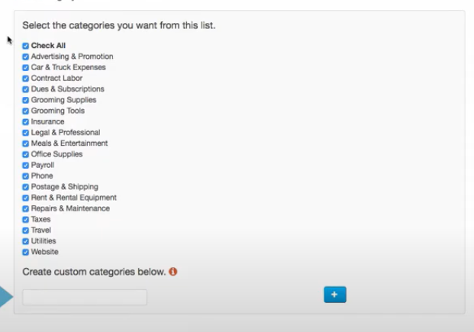
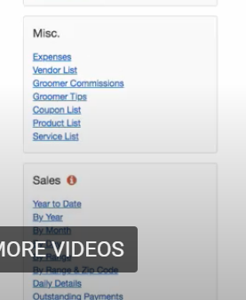
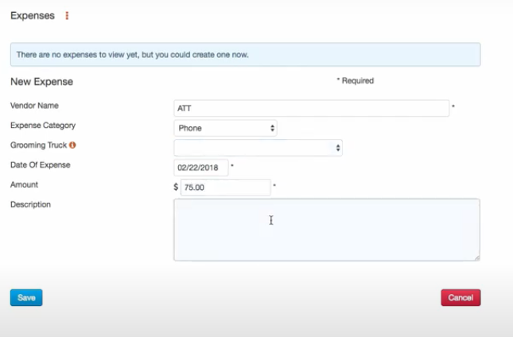

Slide 12
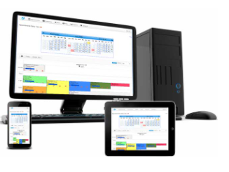
Cross Platform Software:
Since we are logging into your account via the internet there is no OS requirement. Groomsoft will work on any device (Mac, Windows, Android, Apple) that has an internet connection. Groomsoft has been tested on the most popular internet browsers such as Edge, Chrome, Firefox and Safari.

Slide 13
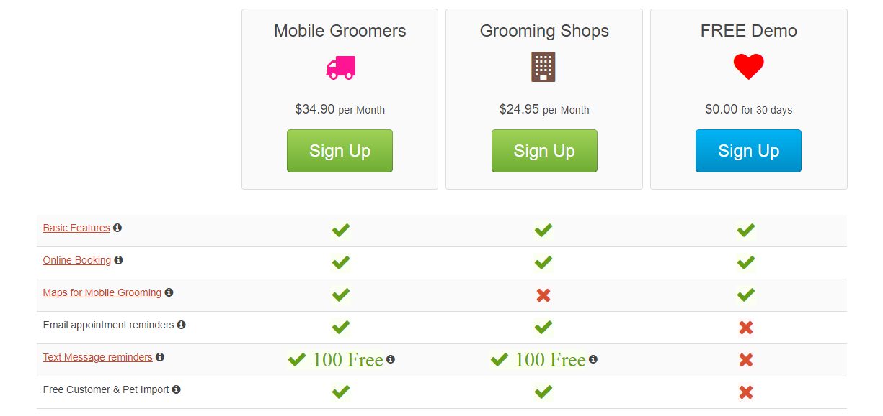
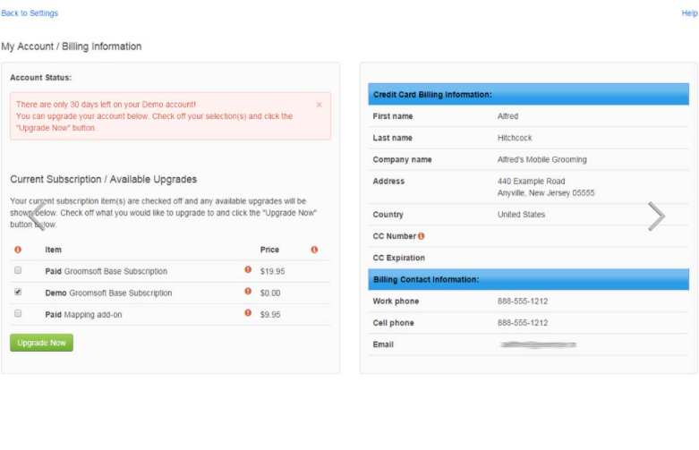
Pricing:
They charge $34.90 to mobile groomers and $24.95 for grooming shops as they don’t have maps feature.
In this package you get free email reminder and 100 free text messages monthly and 500 yearly.
They also provide free demo for 30 days.

Slide 14
Thank you

